Slide 1
02/05/2022
Need whiteboards and calculators.
Title: Intro to measurement
Aim:
TBAT calculate the perimeter and area of common geometric shapes.
Plan:
Review conversions of distance and area.
Review calculating the areas of common shapes.
Individual practice on worksheet

Slide 2
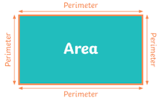
Perimeter
Perimeter – the distance around the outside of a shape.
Area – the amount of space taken up by a 2D shape.
Area

Slide 3


Slide 4
Area
Consider a square that is 1cm by 1cm. It has an area of 1cm².
What is it’s area in mm²?
1cm² = 100mm²
1cm
10mm
?
A = 1cm²
A = 100mm²
1cm
10mm

Slide 5
Whiteboards ready

Slide 6
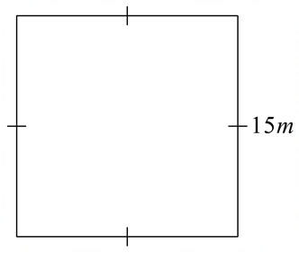
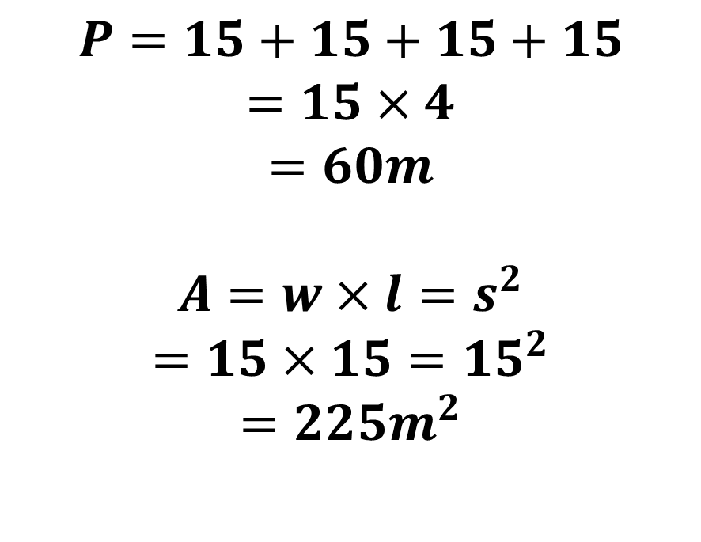
What is the perimeter and area of this shape?
$$P=15+15+15+15$$
$$=15×4$$
$$=60m$$
$$A=w×l=s^{2}$$
$$=15×15={15}^{2}$$
$$=225m^{2}$$

Slide 7
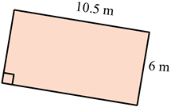
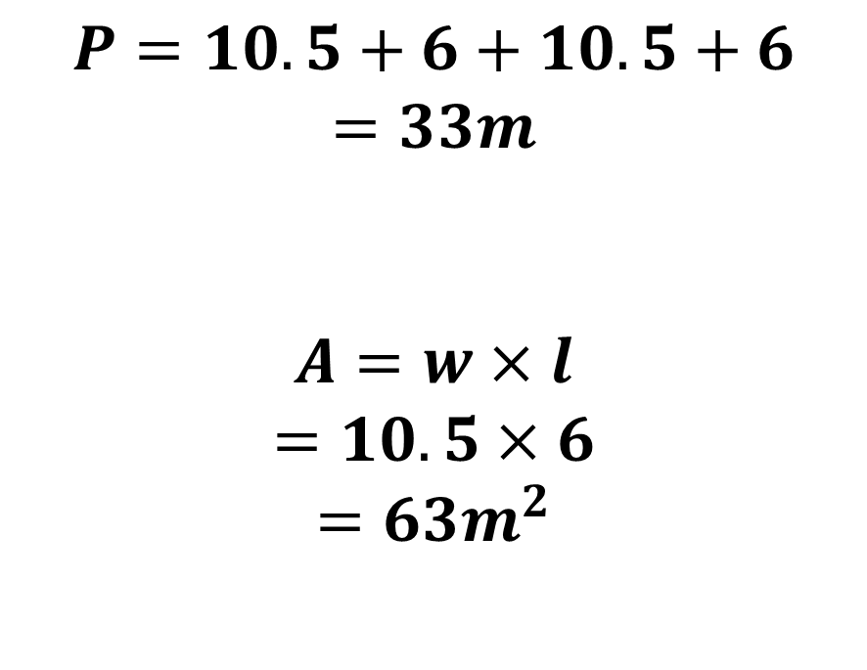
What is the perimeter and area of this shape?
$$P=10.5+6+10.5+6$$
$$=33m$$
$$A=w×l$$
$$=10.5×6$$
$$=63m^{2}$$

Slide 8

Area of Triangles
Area of a triangle = ½ x base x height
= $0.5 ×b h$
Height
Base

Slide 9
Base and height are always perpendicular to each other
Perpendicular – “at right angles to”

Slide 10

Area of Triangles
Area =$\frac{base × height}{2}=\frac{1}{2}×base×height=0.5×base×height=0.5bh$
base
height
height
height
base
base

Slide 11
Whiteboards ready

Slide 12
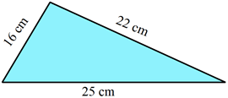
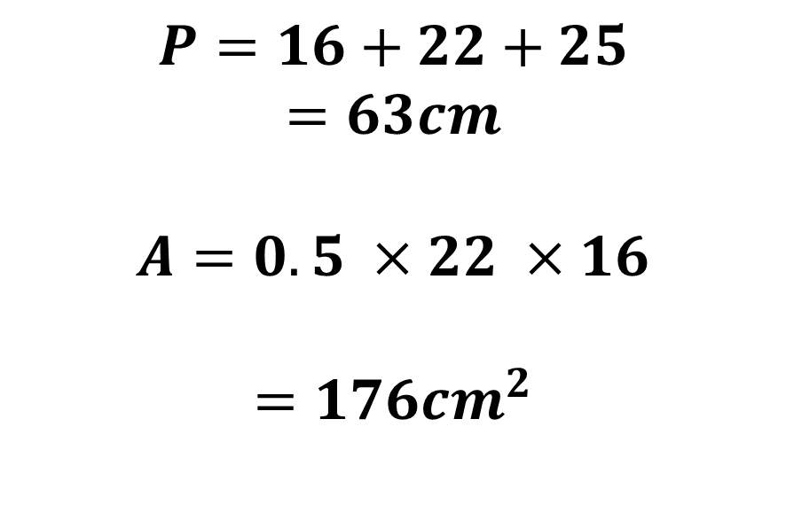
What is the perimeter and area of this shape?
$$P=16+22+25$$
$$=63cm$$
$$A=0.5 ×22 ×16$$
$$=176{cm}^{2}$$

Slide 13
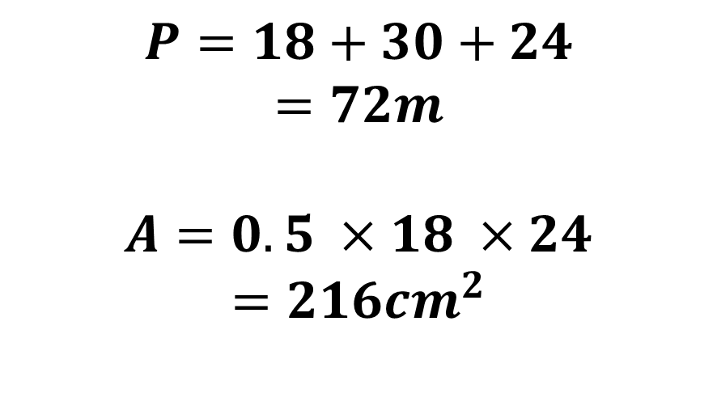
What is the perimeter and area of this shape?
$$P=18+30+24$$
$$=72m$$
$$A=0.5 ×18 ×24$$
$$=216cm^{2}$$
30cm
18cm
24cm

Slide 14
Area of parallelograms
A = base x height
8cm
10cm

Slide 15
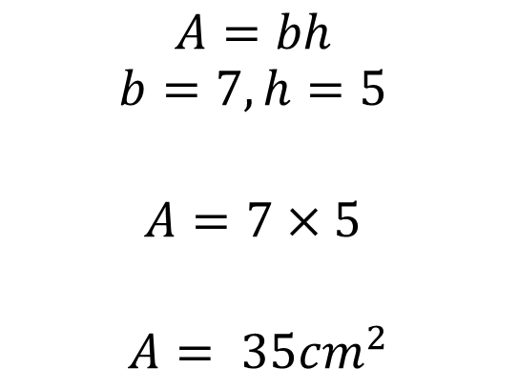
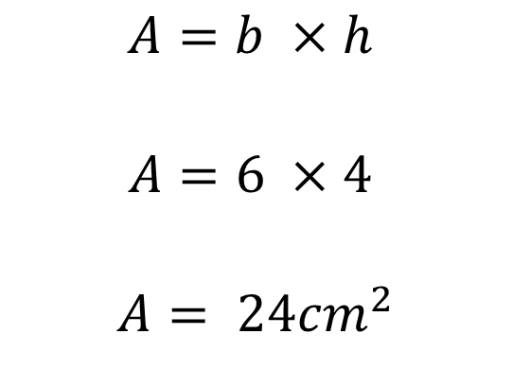
I do
4cm
6cm
$$A=b ×h$$
$$A=6 ×4$$
$$A= {24cm}^{2}$$
$$A=bh$$
$$b=7, h=5$$
$$A=7×5$$
$$A= {35cm}^{2}$$

Slide 16


We do
5cm
10cm
$$A=b ×h$$
$$A=$$
$$A=$$
$$b=11, h=6$$
$$A=$$
$$A=$$

Slide 17

You do
3cm
8cm
$$A=b ×h$$
$$A=$$
$$A=$$
$$b=12, h=5$$
$$A=$$
$$A=$$

Slide 18
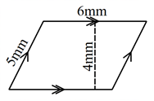
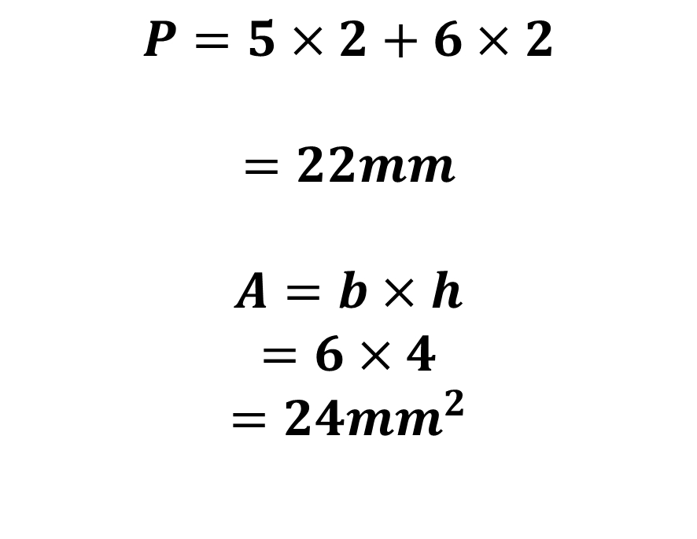
What is the perimeter and area of this shape?
$$P=5×2+6×2$$
$$=22mm$$
$$A=b×h$$
$$=6×4$$
$$=24{mm}^{2}$$

Slide 19

3
Answers:
140cm²
56cm²
180cm²
196cm²
132cm²
240cm²
330cm²
72cm²
72cm²
180cm²
2
1
15cm
14cm
8cm
4
10cm
7cm
12cm
14cm
5
6
7
9cm
12cm
12cm
11cm
15cm
11cm
30cm
20cm
9
8
10
14cm
12cm
18cm
9cm
16cm
12cm
20cm

